Slide 1

P30:Review Analysis for Mi 360° 1080p Full HD WiFi Smart Security Camera product on Amazon.
Team G6
Name: Minal
Vidya
Saarthu
Sudarshan
Rohith

Slide 2
Business Problem:
Business objective-
The main aim of the project is to analyze the review for Mi 360° 1080p Full HD WiFi Smart Security Camera product on Amazon and build an algorithm to find and classify the emotions as Positive, Negative

Slide 3
Project Architecture / Project Flow
1.Understanding Business Objective
2.Getting data set details
3.EDA:Exploratory Data Analysis
4.Model Building
5.Evaluate the model
6.Data Visualizations
7.Deployment Frame

Slide 4
Exploratory Data Analysis (EDA) and
Feature Engineering

Slide 5
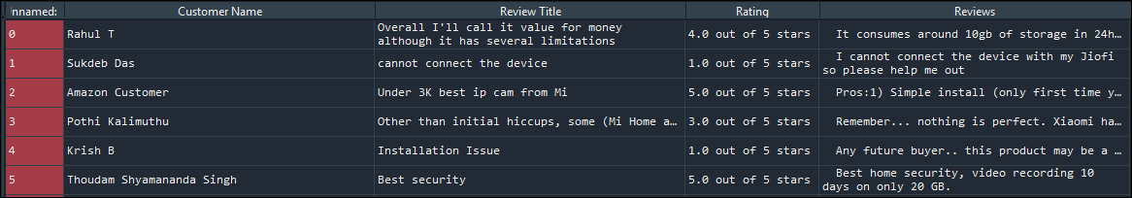
Data set details
The data set has 5 columns and 4210 rows.
Contains zero missing values.
Consists of categorical/alphanumeric values.
There are no duplicate values.
These are the explanations for variables.
Customer name (object): Customer names who bought the camera.
Review Title (object):Title of the reviews given by the customers.
Rating (object): Rating by customers on Camera.
Reviews (object):Customer reviews

Slide 6
Data Pre-processing steps
EDA
removing punctuations & Whitespaces
removing stop words
Lemmatization
Top 20 Frequent words
word cloud generation
top 10 bigrams
Sentimental Analysis

Slide 7
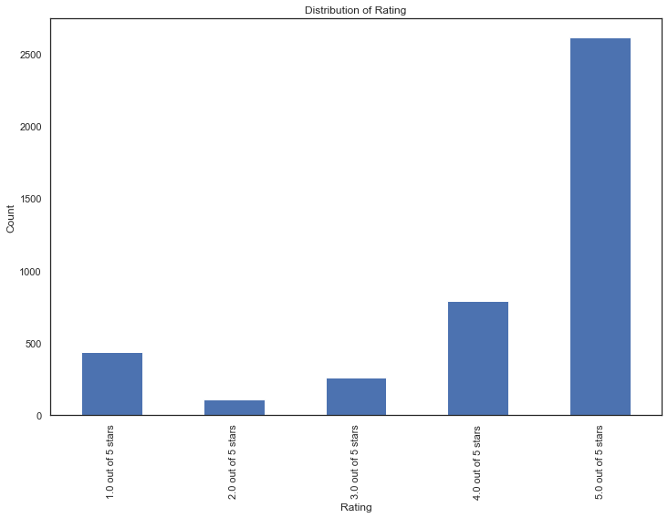
Data Visualization :
The above graph represents the distribution of ratings on the product. The rating is given in the range of 0 to 5

Slide 8
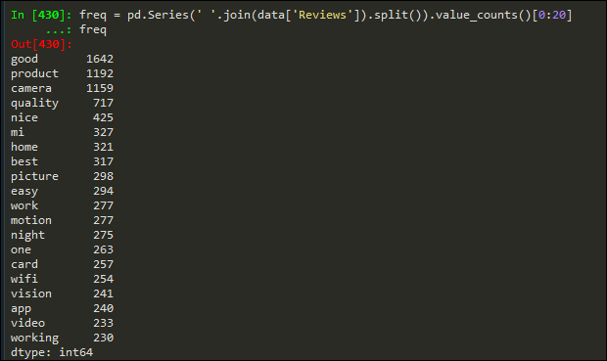
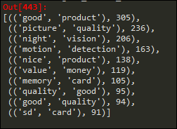
EDA
The above table represents the top 20 words used in the reviews column.
The table represents the top 10 bigrams in the reviews column.

Slide 9
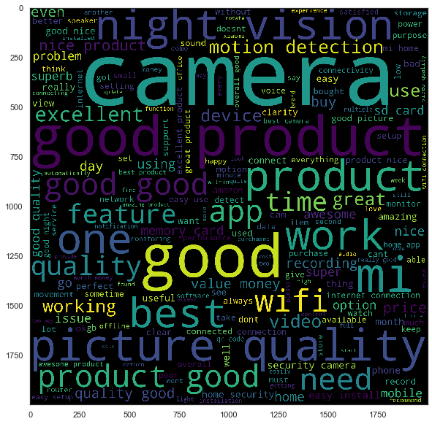
WordCloud :
Word cloud represents the combination of positive, negative and neutral words from Reviews of the customers

Slide 10
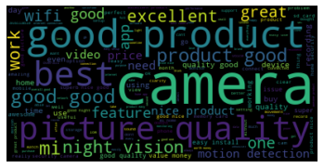
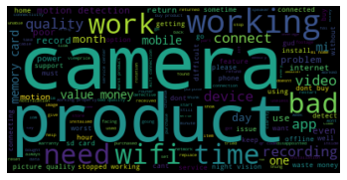
Wordcloud for top 150 Positive words in the Reviews column of the dataset.
Word Cloud for Positive and Negative words
Wordcloud for top 150 Negative words in the Reviews column of the dataset.

Slide 11
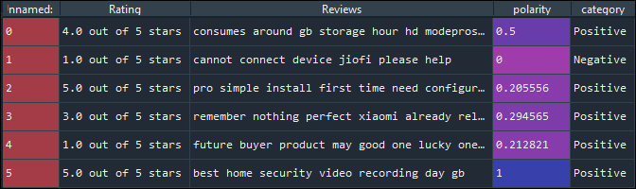
Sentiment Analysis Sentiment analysis is the interpretation and classification of emotions (positive, negative and neutral) within text data using text analysis techniques. Sentiment analysis - Done by TextBlob library If the text is >0 then its polarity value is positive else negative when its =0 then neutral with no sentiments
Sentiment Analysis :

Slide 12
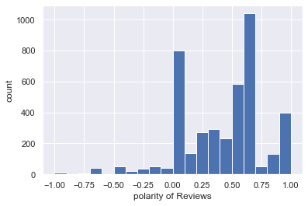
Most of the observation in Reviews are positive. Positive polarity reaches till 1 and negative polarity up to -1.

Slide 13
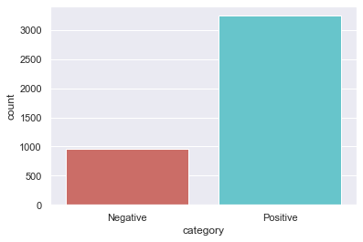
Here we considered the polarities which are above as positive and polarity values less than and equal to zero as negative. So Category is dependent variable and Reviews is independent variable.Also we can observe Positive reviews are move compared to negative reviews.
How to solve Class Imbalance?
By using SMOTE technique we are trying to solve class imbalance problem
SMOTE : stands for Synthetic Minority Oversampling Technique. This is a statistical technique for increasing the number of cases in your dataset in a balanced way. The module works by generating new instances from existing minority cases that you supply as input.

Slide 14
Model Building

Slide 15
Model Building
Following are the models used for Model building in this project:
1)Logistic regression.
2)Decision tree classifier.
3) Random forest classifier.
4) Extra tree Classifier.
5) Support Vector Machine(SVM) Classifier.
6)Neural Networks
7)Bagging classifier method.
8)Linear SVM.
9)Naïve Bayes classifier.
10)XGB Classifier.

Slide 16
Model building Results before SMOTE:
Model Used | Category | Precision | Recall | f1-score | Number of errors | Test Accuracy | Train Accuracy
Logistic Regression | Negative | 0.92 | 0.78 | 0.84 | 84 | 0.93 | 0.97
 | Positive | 0.94 | 0.98 | 0.96
Decision Tree Classifier | Negative | 0.89 | 0.91 | 0.9 | 58 | 0.95 | 0.99
 | Positive | 0.97 | 0.97 | 0.97
Random Forest Classifier | Negative | 0.86 | 0.89 | 0.88 | 73 | 0.94 | 0.99
 | Positive | 0.97 | 0.96 | 0.96
Extra tree Classifier | Negative | 0.92 | 0.88 | 0.9 | 57 | 0.95 | 0.99
 | Positive | 0.97 | 0.98 | 0.97
SVM Classifier | Negative | 0.91 | 0.8 | 0.85 | 80 | 0.93 | 0.99
 | Positive | 0.94 | 0.98 | 0.96
Neural Networks | Negative | 0.72 | 0.94 | 0.82 | 120 | 0.99 | 0.99
 | Positive | 0.98 | 0.89 | 0.94
Bagging Classifier | Negative | 0.84 | 0.94 | 0.98 | 68 | 0.94 | 0.99
 | Positive | 0.98 | 0.95 | 0.96
Linear SVC Classifier | Negative | 0.88 | 0.9 | 0.89 | 65 | 0.94 | 0.99
 | Positive | 0.97 | 0.96 | 0.97
Naïve Bayes Classifier | Negative | 0.97 | 0.11 | 0.19 | 260 | 0.79 | 0.82
 | Positive | 0.79 | 1 | 0.88
XGB Classifier | Negative | 0.86 | 0.92 | 0.89 | 69 | 0.94 | 0.98
 | Positive | 0.97 | 0.95 | 0.96

Slide 17
Model building Results after SMOTE:
Model Used | Category | Precision | Recall | f1-score | Number of errors | Test Accuracy | Train Accuracy
Logistic Regression | Negative | 0.73 | 0.97 | 0.83 | 111 | 0.91 | 0.95
 | Positive | 0.99 | 0.9 | 0.94
Decision Tree Classifier | Negative | 0.86 | 0.93 | 0.9 | 63 | 0.95 | 0.99
 | Positive | 0.98 | 0.96 | 0.97
Random Forest Classifier | Negative | 0.85 | 0.94 | 0.89 | 65 | 0.94 | 0.99
 | Positive | 0.98 | 0.95 | 0.97
Extra tree Classifier | Negative | 0.86 | 0.89 | 0.88 | 73 | 0.94 | 0.99
 | Positive | 0.97 | 0.96 | 0.96
SVM Classifier | Negative | 0.92 | 0.79 | 0.85 | 82 | 0.93 | 0.99
 | Positive | 0.94 | 0.98 | 0.96
Neural Networks | Negative | 0.79 | 0.87 | 0.83 | 105 | 0.91 | 0.99
 | Positive | 0.96 | 0.93 | 0.95
Bagging Classifier | Negative | 0.84 | 0.94 | 0.89 | 69 | 0.94 | 0.99
 | Positive | 0.98 | 0.95 | 0.96
Linear SVC Classifier | Negative | 0.85 | 0.94 | 0.89 | 66 | 0.94 | 0.99
 | Positive | 0.98 | 0.95 | 0.97
Naïve Bayes Classifier | Negative | 0.83 | 0.8 | 0.82 | 105 | 0.91 | 0.97
 | Positive | 0.94 | 0.95 | 0.95
XGB Classifier | Negative | 0.84 | 0.94 | 0.89 | 70 | 0.94 | 0.97
 | Positive | 0.98 | 0.94 | 0.96
Observation: From the results we can observe less error (63) for decision tree model and training and testing accuracy is 0.99 and 0.95.So, finalized Decision Tree Classifier as our final model and it is used in model deployment part

Slide 18
Cohen_kappa_Score before and after SMOTE:
Model Used | cohen_kappa_score_before SMOTE
Logistic Regression | 0.8
Decision Tree Classifier | 0.87
Random Forest Classifier | 0.83
Extra tree Classifier | 0.87
SVM Classifier | 0.81
Neural Networks | 0.75
Bagging Classifier | 0.85
Linear SVC Classifier | 0.85
Naïve Bayes Classifier | 0.15
XGB Classifier | 0.84
Model Used | cohen_kappa_score after SMOTE
Logistic Regression | 0.77
Decision Tree Classifier | 0.86
Random Forest Classifier | 0.85
Extra tree Classifier | 0.83
SVM Classifier | 0.8
Neural Networks | 0.77
Bagging Classifier | 0.85
Linear SVC Classifier | 0.85
Naïve Bayes Classifier | 0.76
XGB Classifier | 0.85

